Slide 1
Twitter Sentiment Analysis Using Machine Learning and Deep Learning
PIP2001 Capstone Project
Review-0
Batch Number:184
Roll Number | Student Name
20211CSE0123 20211CSE0151 20211CSE0130 20211CSE0012 | R.Reddy Ruchitha S.Saraswathi Sree Moulya D.Ganesh Reddy G.Siva Sai Krishna
Under the Supervision of,
Dr.Taranath N L
Associate Professor
School of Computer Science and Engineering
Presidency University
Name of the Program: CSE
Name of the HoD: Dr.Asif Mohammed H.B
Name of the Program Project Coordinator: Mr. Amarnath J.L & Dr. Jayanthi. K.
Name of the School Project Coordinators: Dr. Sampath A K / Dr. Abdul Khadar A / Mr. Md Ziaur Rahman

Slide 2
Content
Problem Statement
Analysis of Problem Statement
Github Link
Timeline of the Project
References

Slide 3
Problem Statement
Social media platforms like Twitter have become major sources of real-time opinions and sentiments on various topics. Sentiment analysis of tweets helps in understanding public opinion, predicting trends, and assisting businesses in decision-making. However, analyzing sentiments in tweets is challenging due to short text length, informal language, slang, and sarcasm. Our project aims to build a sentiment analysis model using both traditional machine learning techniques and deep learning models to achieve high accuracy in classifying tweets as positive or negative.

Slide 4
Abstract
This project focuses on sentiment analysis of Twitter data employing both traditional machine learning techniques and deep learning models.
By leveraging natural language processing methods, we aim to extract sentiments from tweets accurately.
Through a comparative analysis of the effectiveness of machine learning algorithms and deep learning architectures, we seek to identify the most suitable approach for sentiment classification in the dynamic and noisy environment of social media.

Slide 5
Introduction
In the era of social media dominance, Twitter has emerged as a rich source of real-time opinions and sentiments on diverse topics spanning from politics to product reviews.
Our objective is to develop robust methods capable of accurately classifying the sentiment expressed in tweets. By employing natural language processing (NLP) techniques, we aim to preprocess the textual data, extracting relevant features that capture the nuances of human expression.
Subsequently, we will explore a variety of machine learning algorithms, ranging from classic approaches such as Support Vector Machines (SVM) and Random Forests to more recent advancements like Gradient Boosting and ensemble methods.
Additionally, we will delve into the realm of deep learning, experimenting with architectures such as Convolutional Neural Networks (CNNs) and Recurrent Neural Networks (RNNs) to capture the contextual information inherent in sequential data like tweets.

Slide 6
Problem Statement Number: PSCS_74
Organization: Ministry of Commerce and Industries
Category (Hardware / Software / Both) : Software
Problem Description:
This problem involves developing a sentiment analysis solution specifically designed for analyzing the sentiment expressed in the social media presence of individuals and organizations. With the significant impact of social media on personal and organizational reputation, understanding the sentiment of social media posts, comments, and interactions has become essential for individuals and businesses alike. Sentiment analysis refers to the process of automatically determining the sentiment or emotional tone conveyed by text or speech. In the context of social media, sentiment analysis can provide valuable insights into public perception, customer feedback, and brand reputation. By analyzing the sentiments expressed in social media content, individuals and organizations can gauge the overall sentiment trends, identify potential issues, and take appropriate actions to maintain or enhance their online presence.
Difficulty Level:Complex
Problem Statement Number: PSCS_74

Slide 7
Analysis of Problem Statement
Technology Stack:
Programming Language: Python
Libraries & Frameworks: NLTK, Scikit-Learn, TensorFlow/Keras, Pandas, Matplotlib, Word2Vec/GloVe
Machine Learning Models: Support Vector Machines (SVM), Random Forest, Logistic Regression
Deep Learning Models: Convolutional Neural Networks (CNN), Recurrent Neural Networks (RNN), BiLSTM
Dataset: 100,000 tweets with labels (Positive/Negative)

Slide 8
Analysis of Problem Statement(contd...)
Software :
Software: Python, Jupyter Notebook, Google Colab, TensorFlow/Keras, Scikit-Learn
Challenges & Solutions:
Short & Noisy Text → Used NLP techniques like tokenization, stop-word removal, and stemming
Handling Sarcasm & Context → Used deep learning models (BiLSTM, CNN) for better context understanding
Real-time Data Processing → Implemented optimized preprocessing pipelines for faster execution

Slide 9
Github Link
The Github link provided should have public access permission.
Github Link
https://github.com/Moulya08/SENTIMENT-ANALYSIS-OF-SOCIAL-MEDIA-PRESENCE-

Slide 10
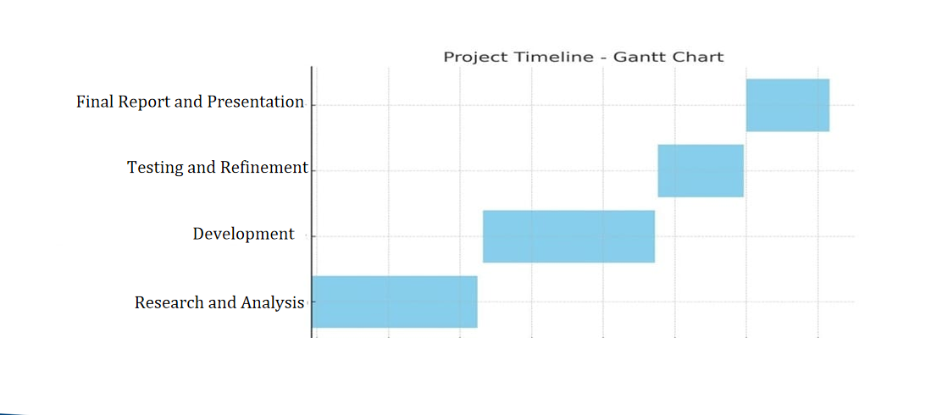
Timeline of the Project

Slide 11
References (IEEE Paper format)
"SentiDiff: Combining Textual Information and Sentiment Diffusion Patterns for Twitter Sentiment Analysis"
Journal: IEEE Transactions on Knowledge and Data Engineering, 2020
Methodology: Sentiment classifiers combined with sentiment diffusion analysis using the SentiDiff algorithm.
"Deep Convolution Neural Networks for Twitter Sentiment Analysis"
Used deep CNNs and experimented with different feature combinations (BoW, sentiment polarity, GloVe embeddings).
"A Deep Learning-Based Sentiment Analysis Approach (MF-CNN-BiLSTM) and Topic Modeling of Tweets Related to the Ukraine–Russia Conflict"
Applied LDA for topic modeling and MF-CNN-BiLSTM for sentiment classification.
"TSA-CNN-AOA: Twitter Sentiment Analysis Using CNN Optimized via Arithmetic Optimization Algorithm"
Compared CNN with SVM, Naïve Bayes, and decision trees to enhance classification accuracy.

Slide 12


